Slide 1
Mid-Course Project

Slide 2
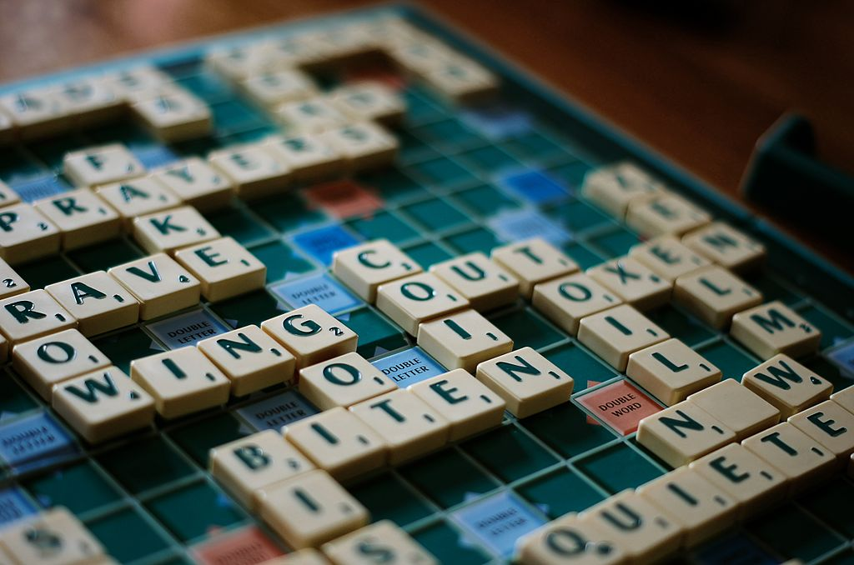
The Game of Scrabble
The goal of scrabble is to place letters onto a 15x15 grid of squares in a way that maximizes your total points

Slide 3
Your Objective
Use python to score the highest each turn that you can
Yes, you will learn how to cheat at scrabble!
Accept a list of tiles and return the ranking of all permutations of those tiles that are valid words
Be sure to try and leverage Test Driven Design
See the assignment for more details

